Slide 1
Covid-19 Sentiment Analysis
TEAM NAME: HellRaisers
Team Members: UGENTHAR V(Lead), VENKATESH S, SARAVANA T, VIDHYA S.
Application ID:- SPS_CH_APL_20200001318
Project id: SPS_PRO_331

Slide 2
Description
The sentiment analysis of Indians after the extension of lockdown announcements to be analyzed with the relevant #tags on twitter and build a predictive analytics model to understand the behavior of people if the lockdown is further extended.Also develop a dashboard with visualization of people reaction to the govt announcements on lockdown extension

Slide 3
Problem Statement:
People don't know whether the Lockdown is extended or not.
People don't know the current situation of the pandemic ie; Corona.
Due to this people will be easily affected.
For example: If a person is going to the particular area in the city he/she doesn't know that the area is affected or not.
By this there may be large possibility of corona spread.The other problem is that they don't have the accurate awareness about the pandemic.
Sometimes the data that were given in news may not be in real time(not accurate).

Slide 4
Solution:
Dashboard that Shows the realtime sentiment about the pandemic(corona).
Simple application that gives some tips to fight against corona.
Sentiment will be generated based on the tweets from the Twitter.

Slide 5
Sentiment Analysis:
Definition given in internet:
the process of computationally identifying and categorizing opinions expressed in a piece of text, especially in order to determine whether the writer's attitude towards a particular topic, product, etc. is positive, negative, or neutral.

Slide 6
How to get tweets from twitter?
Inorder to get tweets from twitter we should have an API key for the twitter account .
Go to developer's Account link: https://developer.twitter.com/en
Give details and get your API key.
We can use this API Key in the twitter node in the nodered platform.

Slide 7
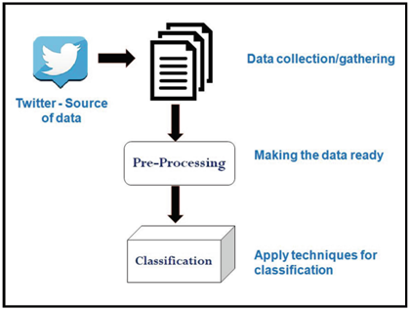
How Tweets are classified?

Slide 8
Node-red Platform:
Node-red Platform helps to create our own dashboard .
It doesn't require any complex programming skill.
The basic skill of json,html,css,js is needed to work with this platform.

Slide 9
Important Nodes For Sentiment Analysis:
1] Twitter Node
2] Sentiment Node
3] Function Node
4] Feed Parser Node
5] UI-dashboard nodes
6] Audio Node
7] Template node
8] http request and http response node\

Slide 10
About Nodes:
1]Twitter Node:
It is the input node for the sentiment analysis project.Twitter account id, Api key,Access Tokens are needed to connect the twitter node to the twitter account.
Inorder to get the tweets about specific topic we can use #,@ i have used '#corona' to get the tweets about the corona.
2] Sentiment Node:
It is most important node used to generate sentiment .the ouput will be like(msg.sentiment.score)

Slide 11
About Nodes:
3] Function Node:
We cannot directly connect the sentiment node to the ui-dashboard nodes like(gauge, chart etc;) because the output of the sentiment node is in the format of(msg.sentiment.score) but the ui-dashboard nodes accept only the msg.payload in that situation we can use function node between the sentiment node and ui-dashboard nodes(msg.payload=msg.sentiment.score);
We can also use function node to run the java script code.

Slide 12
About Nodes:
4] Feedparser: The input for this node is the url. We can use rss feed links of any news channel to displayn the news and their sentiment in the dashboard.https://edition.cnn.com/services/rss/
I have used the above link to get the rss feeds to show the news and it sentiment values.
5] UI-dashboard Nodes: These nodes are used to add the gauge, graph,buttons,notifications and like that to over dashboard.
6] Audio Node: It will be used to give the audio output in our dashboard.

Slide 13
About Nodes:
7] Template Node:
This node can be used to design the website. I have used this node to design the registration page and login page for the our website.
8] http request and http response Node:
Http request: this node is used to get request of the webpage. There are methods namely GET & POST method. The GET method is used to open particular page and the POST method is used to post some information to the page. I have used http request , response & template node to create the registration form and login form.

Slide 14
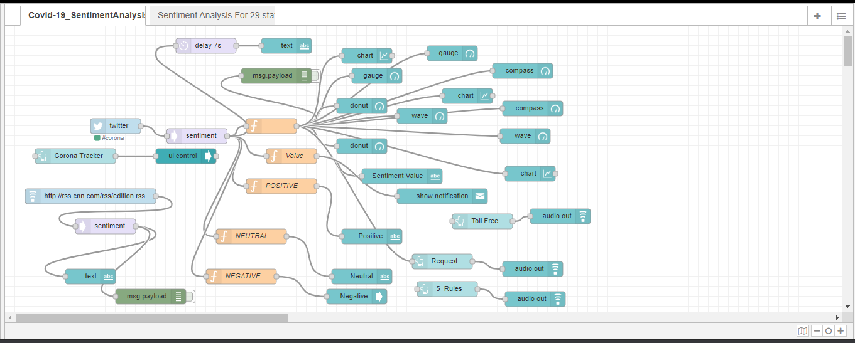
Node-Red Flow For Sentiment Tab:

Slide 15
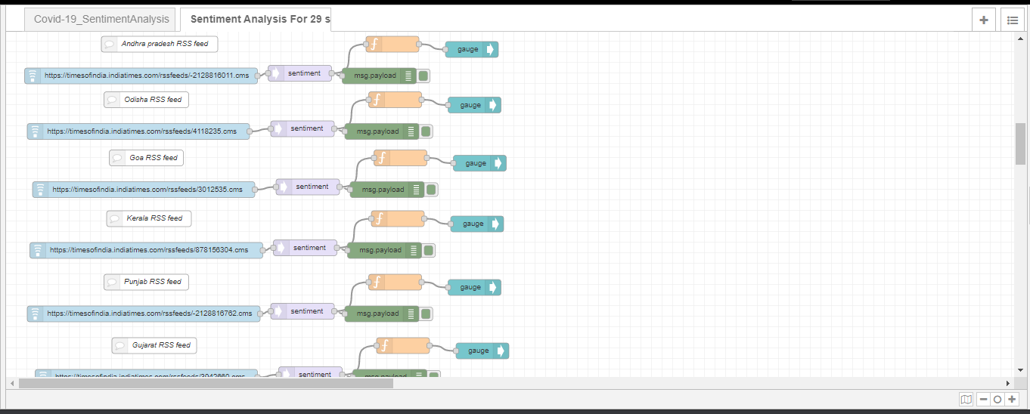
Node-Red Flow For 29 state's Tab:

Slide 16
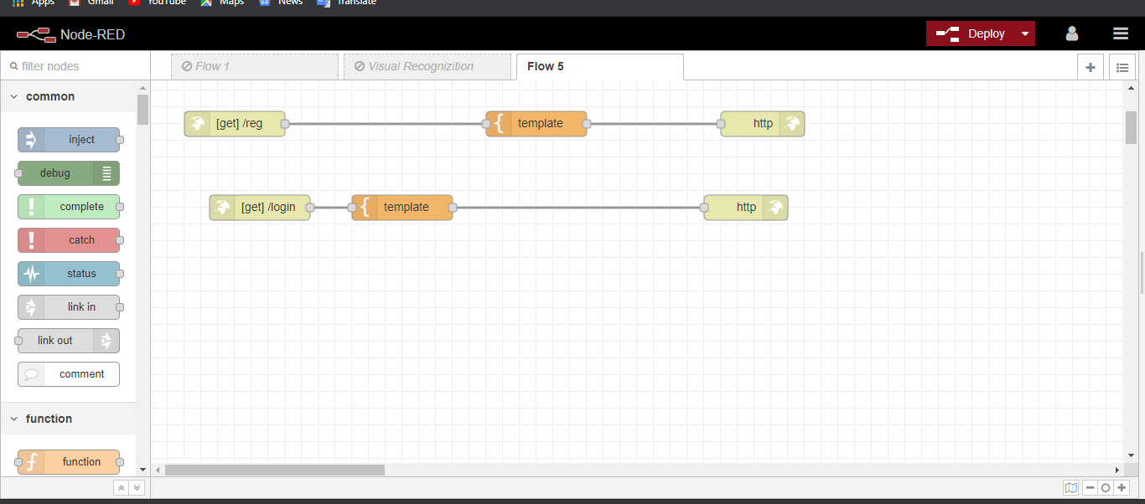
Node-Red Flow for Reg & Login Page:

Slide 17
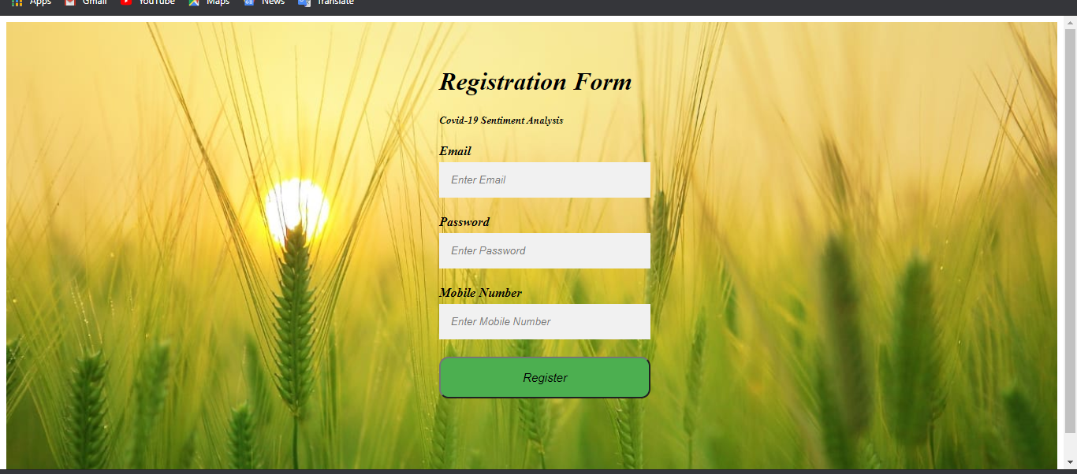
Registration Page Output:

Slide 18
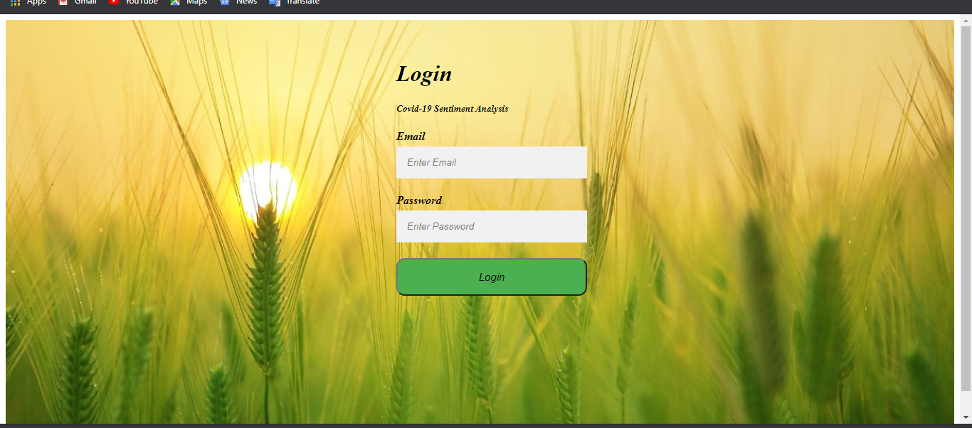
Login Page Output:

Slide 19
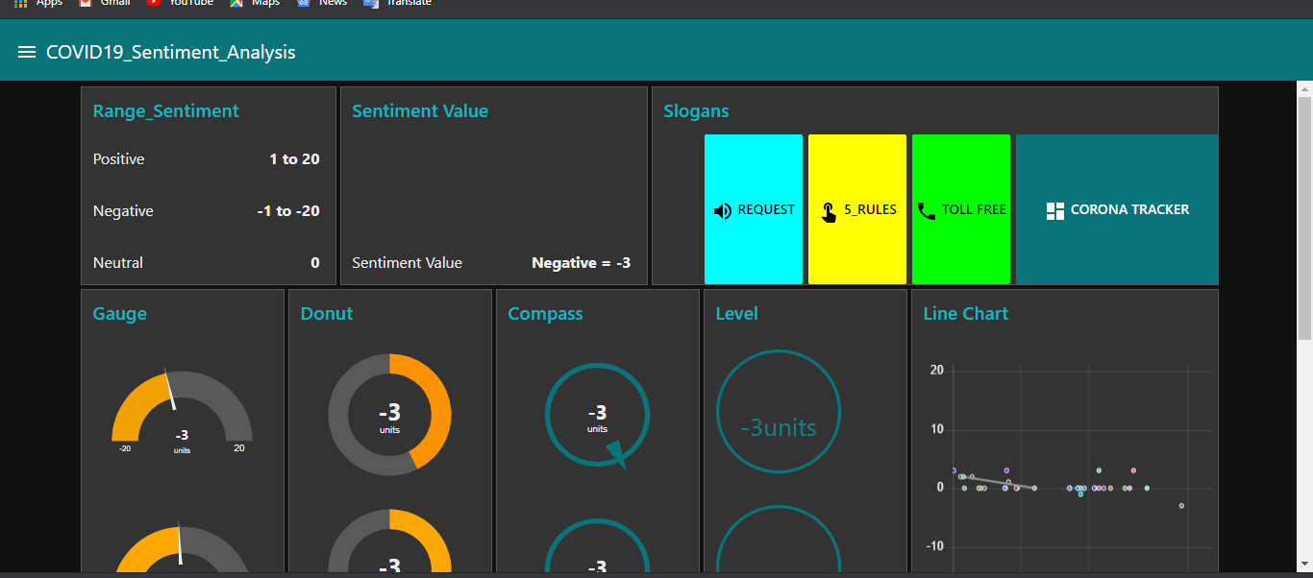
Sentiment Tab Output:

Slide 20
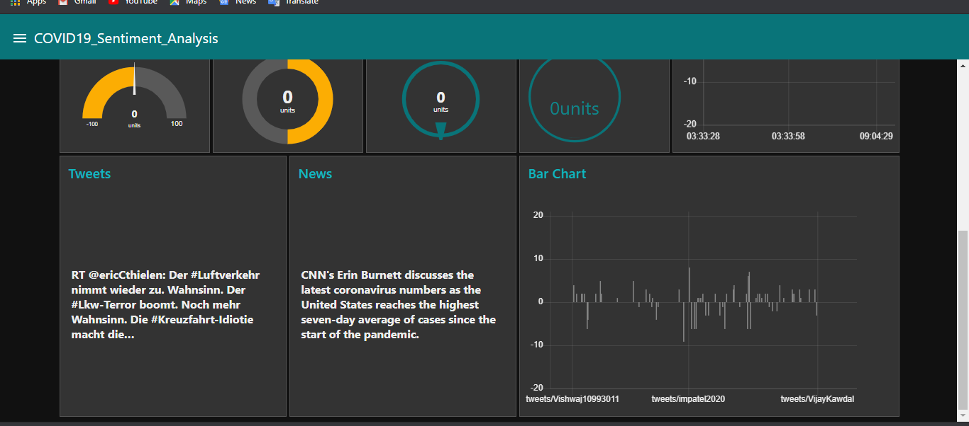
Sentiment Tab Output:

Slide 21
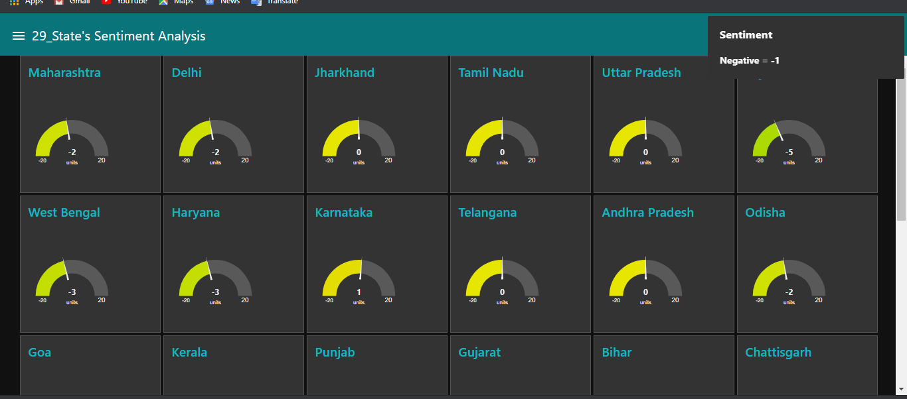
29 State's Tab Output:

Slide 22
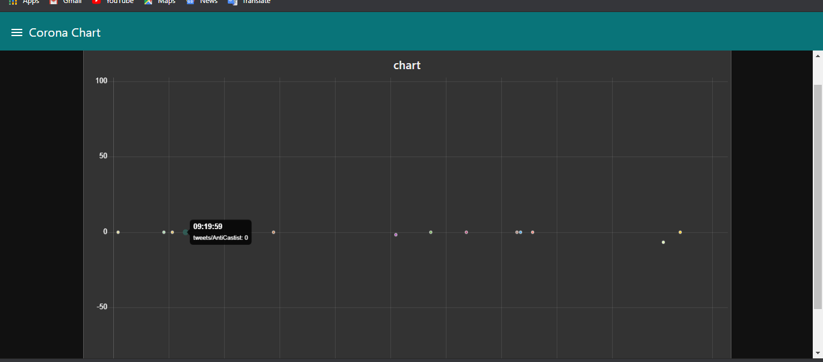
Corona Chart Tab Output:

Slide 23
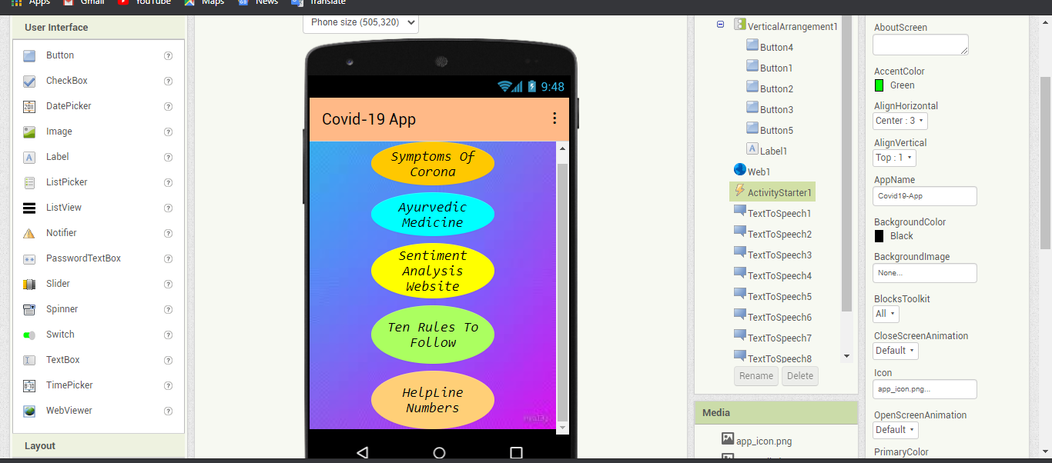
The Covid-19 App Output:

Slide 24
Difficulties Faced:
When we started our project there is lots of difficulties. We even don't know how we are going to develop . But the mentors helped us by keeping bootcamp and they teached us lot of new technologies.
We thought that we should know the complex languages to develop the dashboard but the services provided by IBM made our work very easy.
We very much interested in developing the registration form and login page for our dashboard but we had a problem " How we are going to publish our website? in that situation node-red ,template node and http nodes helped us.

Slide 25
Experience:
Experience that we have earned through this competition is much greater than that we have gained in our college.
Each time when we had an issue to get the output we have found more than 10 ways to solve that issue.
Each time when i started to create the sentiment analysis in the begining we didn't get it after 3 days researching about the sentiment node and twitter node we got the output at last.

Slide 26
Links For Project Output:
Registration Page Link: https://node-red-cyefh.eu-gb.mybluemix.net/reg
Login Page Link:
https://node-red-cyefh.eu-gb.mybluemix.net/login
Dashboard Link:
https://node-red-lqtop.eu-gb.mybluemix.net/ui
Vedio Presentation Link:
https://youtu.be/9SnlDsAZgXw

Slide 27
Development of dashboard , login page and registration page
-by UGENTHAR V
Development of App for sentiment analysis
-by VENKATESH S, SARAVANA T, VIDHYA S.
"THANK YOU FOR YOUR TIME AND CONSIDERATION "

